Slide 1





PCET’s
Pimpri Chinchwad College OF Engineering , GDGC , PUNE
BloodAid
AlphaByte-2.0
Designed & Presentated with❤️ by Team CodeBlooded

Slide 2


meet the team!!
Saanvi K. naik
Computer science Engg.
naiksaanvi96@gmail.com
+919518314351
Mohammed zaki Shahpure
information technology
shahpuresocial@gmail.com
+918668213428
Adhwaith kumar
electronics and comm.
adhu20906@gmail.com
+918484044520
College: PCET’’S pcu
College: mitaoe
College: iiit pune
Designed & Presentated with❤️ by Team CodeBlooded

Slide 3



Problem Statement
During medical emergencies, finding a compatible blood donor or receiving Immediate assistance can be a life-or-death situation. Many patients struggle to access blood due to shortages, delays, or reliance on middlemen. This platform aims to directly connect blood donors with recipients based on location, ensuring timely donations and emergency support without unnecessary delays.t
Blood Donation & Emergengy help (ps-07)

Slide 4
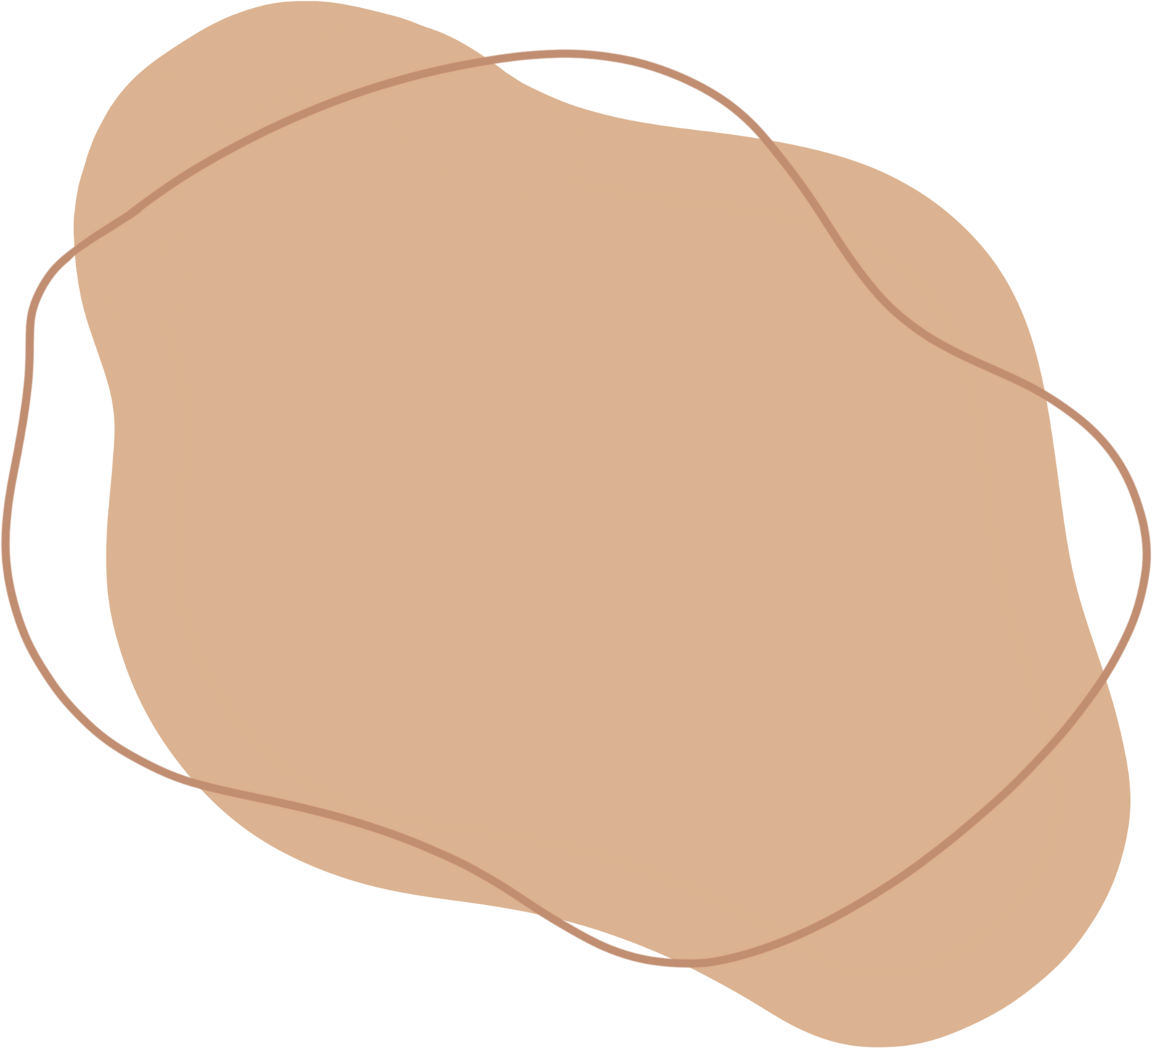
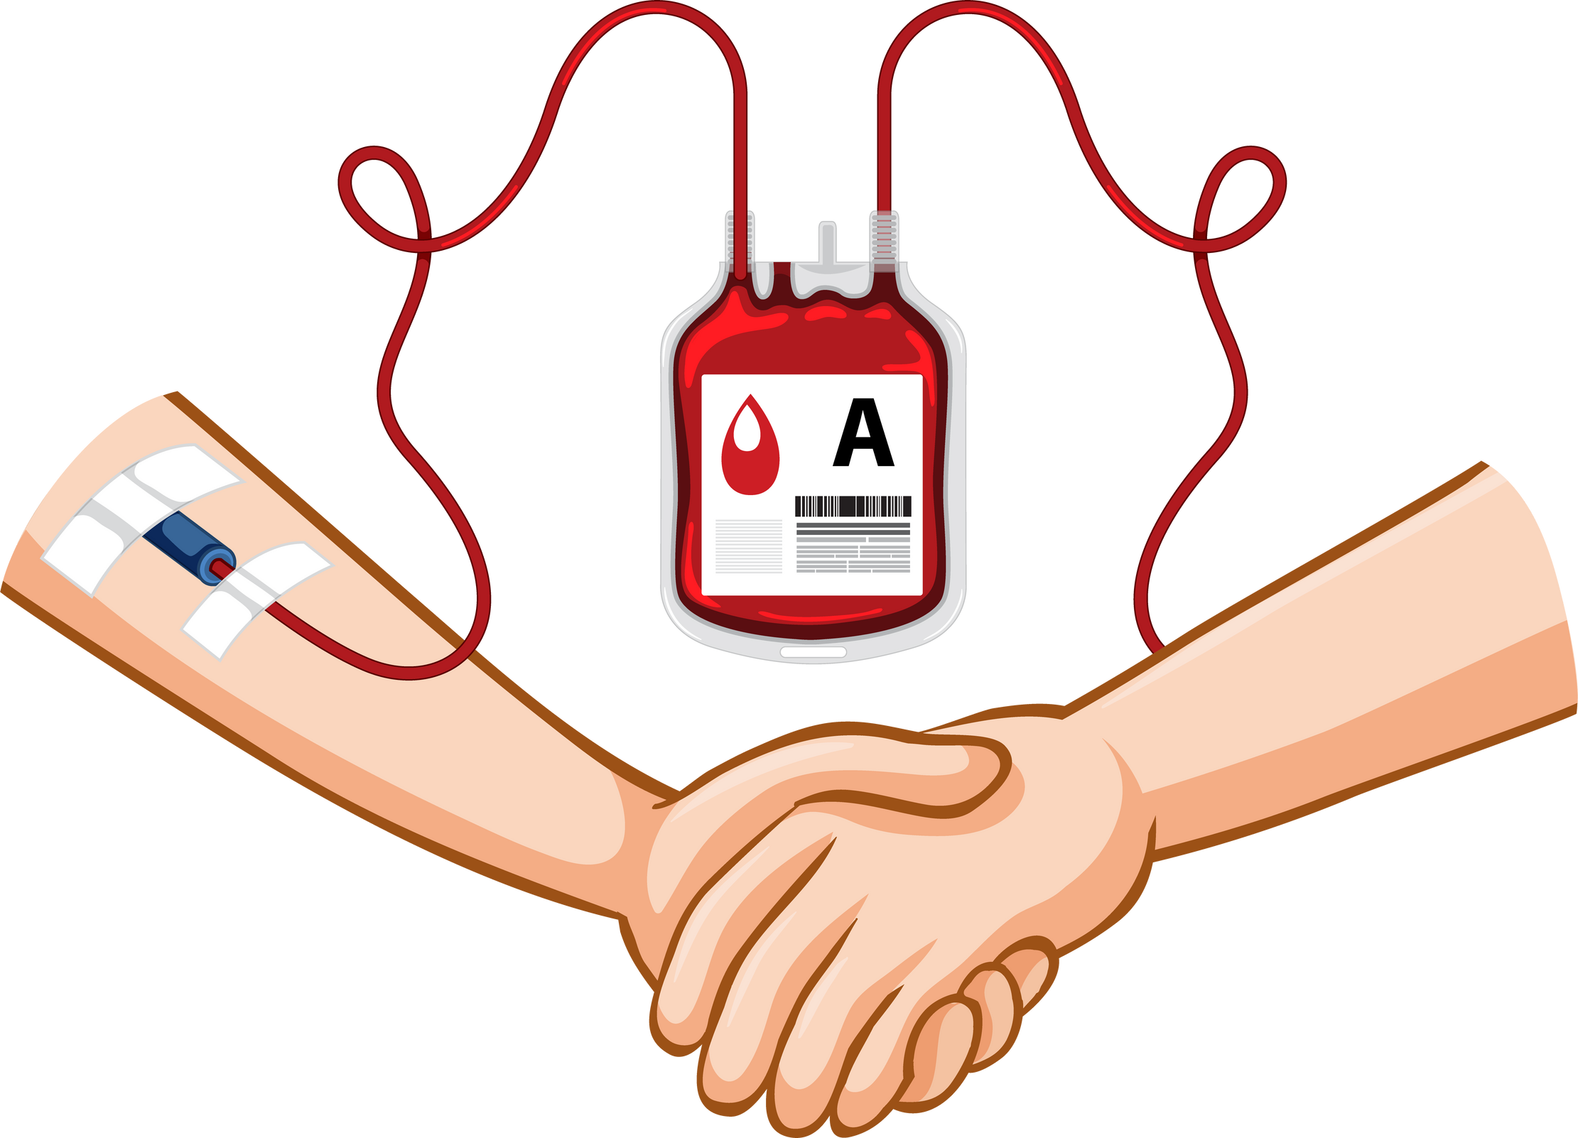

Slide 5

to solve this we present to you a service, a webapp which can easily work on any Platform according to requirement, handling donors & receivers with ease ! ! !
Proposed solution

Slide 6
features
Comprehensive User Profiles
Secure and Scalable Architecture
Responsive and Intuitive Design
View Profile: Access your complete profile, including personal details, blood group, and donation history.
Edit Profile: Update your information anytime to keep your profile current.
Advanced Blood Source Locator
Seamless User Authentication
Sign Up: Create a personalized account in seconds with just your email and password.
Logout: Log out securely with just one click
We ship our module as a webapp - eliminating the need to download the apk thus offers two aspects - mobile webapp and a website(useful for users in emergent need)

Slide 7
FUTURE ASPECTS
--> Real-Time Notifications
Urgent Blood Requests: Get instant notifications about urgent blood needs in your area.
Donation Reminders: Never miss a donation opportunity with timely reminders.
{ We shall be doing this using FCM - Firebase Cloud Messaging as can be used on mobile as well as web}
--> Donation HistorY
We shall also add a donation history tracker on basis of which we shall reward the users for donation which in return will encourage blood donation

Slide 8



aRCHITECTURE & TECH
FLOW CHART
TECH STACK
The user will sign-up/login and enter the dashboard
HTML/CSS
on the profile page of his/her dashboard enter their details along with blood type
Python (FLASK)
Github - FOR VERSION CONTROL
you can search for near by donors on our embeded maps feature and easliy locate the nearest bloodbank
Visual studio Code/Community
in utter emergencies you can visit our emergency section on the dashboard
PROTOTYPE
Click For Repo

